Slide 1
Taking a swim in the big data lake
Tor Hovland

Slide 2


Company vision
Powel delivers software for tomorrow’s energy and environmental needs – today

Slide 3

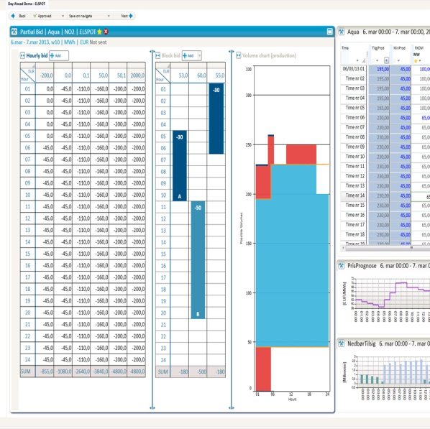
Smart Energy
Maximising renewable power
production and trading

Slide 4

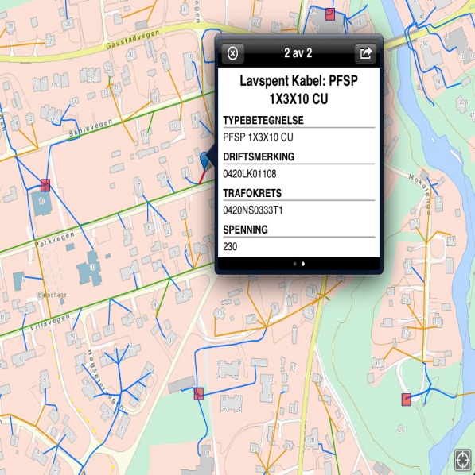
Smart Infrastructure
Helping to make
informed decisions

Slide 5
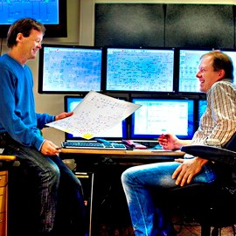
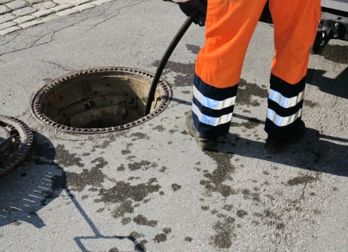
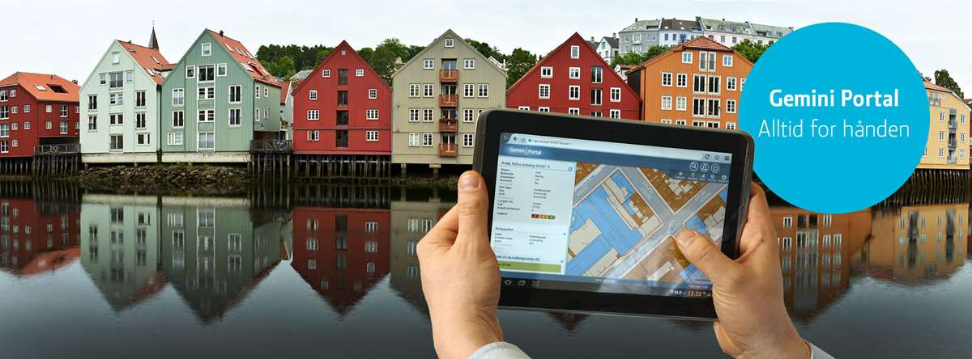
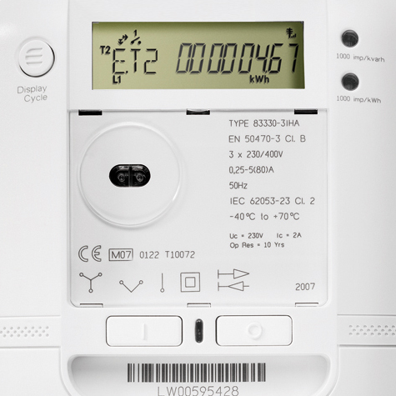
Supporting municipal processes

Slide 6

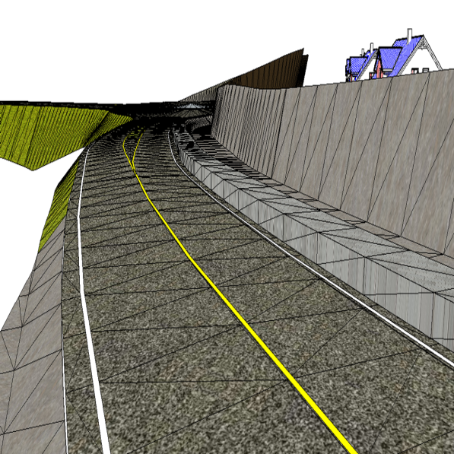
Contracting
Visualising the entire construction
process – start to finish

Slide 7
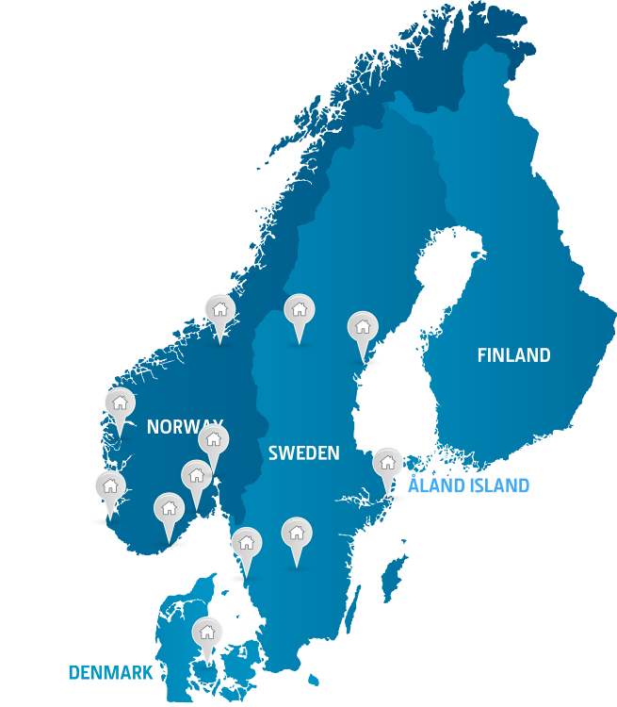
Powel Offices

Slide 8


Slide 9
Big data lake
Storage repository in the cloud
Various sources
Typically a lot of data
Data for the future

Slide 10
Data lake vs data warehouse
Data warehouse: you clean and structure data before storage. (schema-on-write)
Data lake: you store raw data. The user figures out how to query it. (schema-on-read)

Slide 11
Data for the future
When you set up a machine learning experiment, you need historic data.
Storage in the data lake is cheap.
Store everything now, even if you don’t know if you’ll need it.

Slide 12
Azure Data Lake
Apache HBase – Hadoop database
Apache Hive – SQL for Hadoop
Apache Spark – scalable computation
Apache Storm – realtime stream processing
U-SQL – SQL and scalable computation
Azure Stream Analytics – realtime stream processing

Slide 13
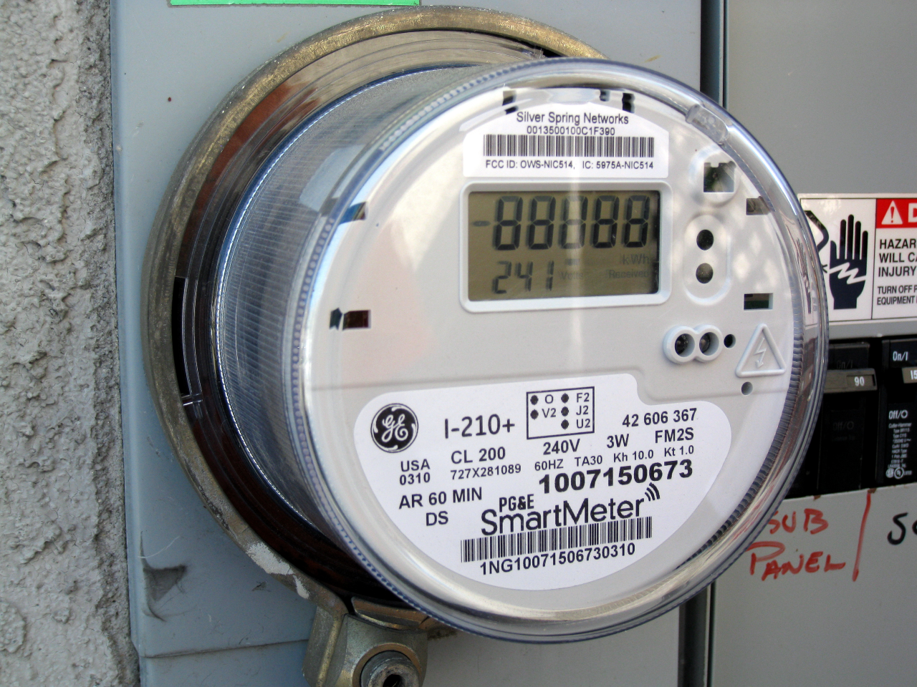
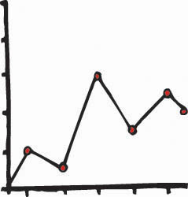
The case
Collection dashboard
Cloud storage
Data queries
Consumption predictions

Slide 14








The building blocks
Web app
Blob storage
for raw data
Machine Learning
Event Hub
Blob storage
for business data
Service Fabric
& Stateful Actors
Data Lake Analytics
& U-SQL
Stream Analytics
Power BI

Slide 15
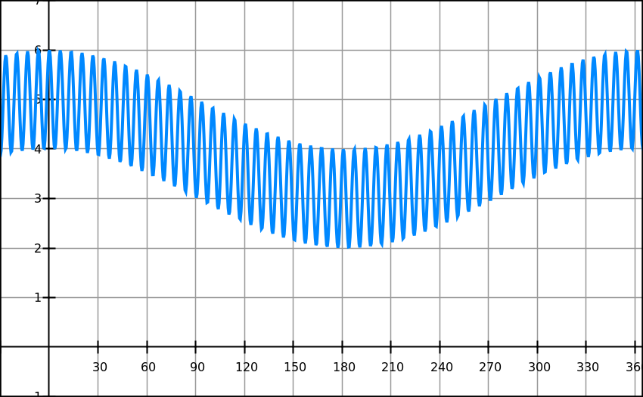
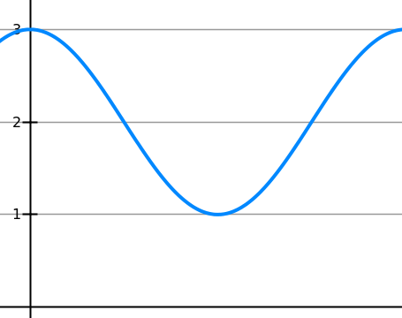
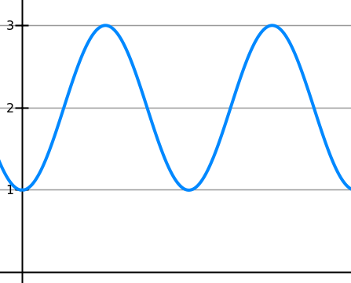
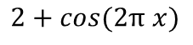
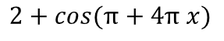
Simulated meter data
Combined pattern
Seasonal pattern
$$2+cos(2π x)$$
Daily pattern
+ a consumption factor because people have different needs
+ some random noise to make it more realistic
$$2+cos(π+4π x)$$

Slide 16
Data load
A small grid company: 10.000 meters on hour resolution.
A big grid company: 1 mill. meters or more on hour resolution.
500 meters on second resolution
equivalent to 500 * 60 * 60 = 1,8 mill. meters on hour resolution.

Slide 17
Meter simulator actors on Service Fabric
Service Fabric
Meter sim
Meter sim
Meter sim
Meter sim
Meter sim
Meter sim booter
Meter sim booter
web client
Meter sim
Meter sim
Meter sim
Meter sim

Slide 18
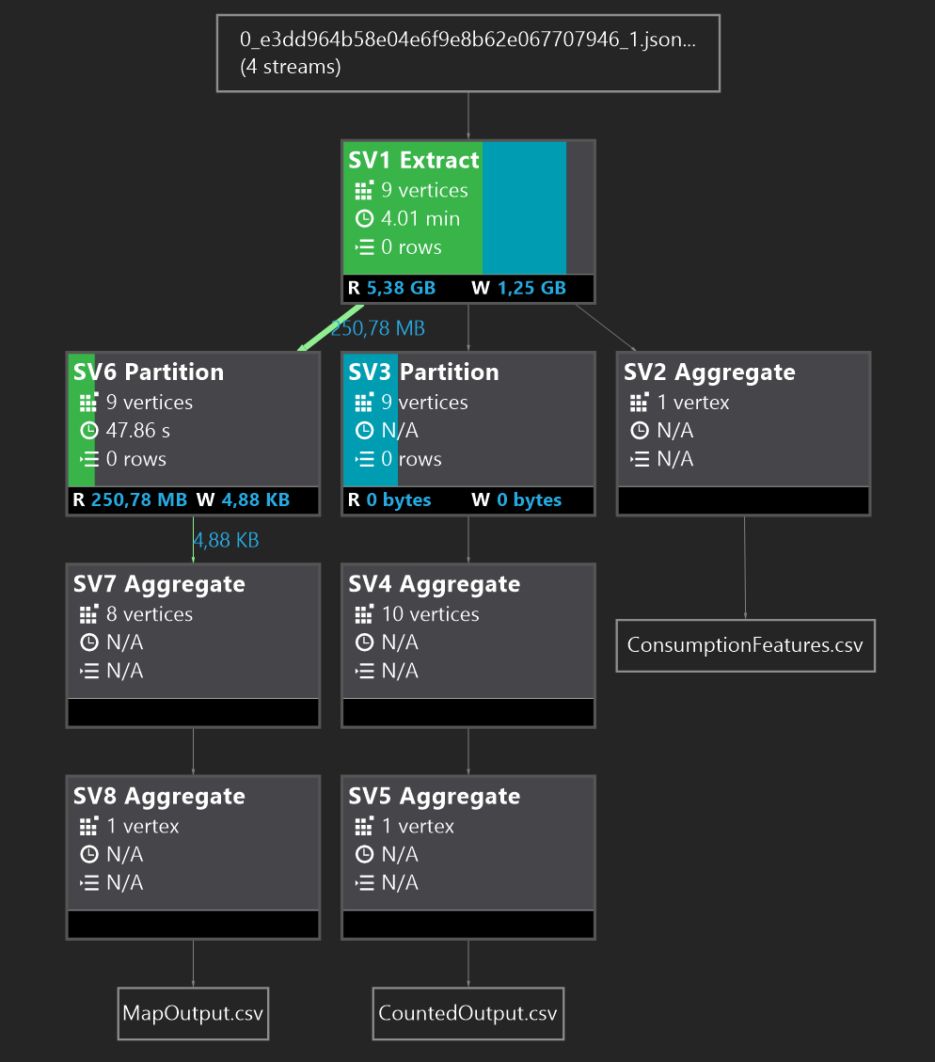
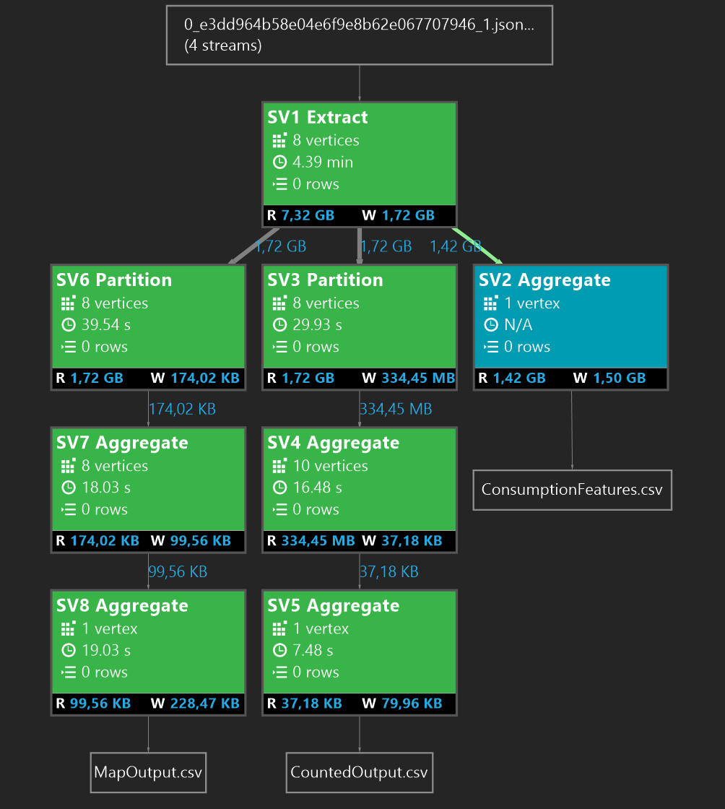

Slide 19
Contact
github.com/torhovland
@torhovland
tor.hovland@powel.com

Slide 20
Demos

Slide 21
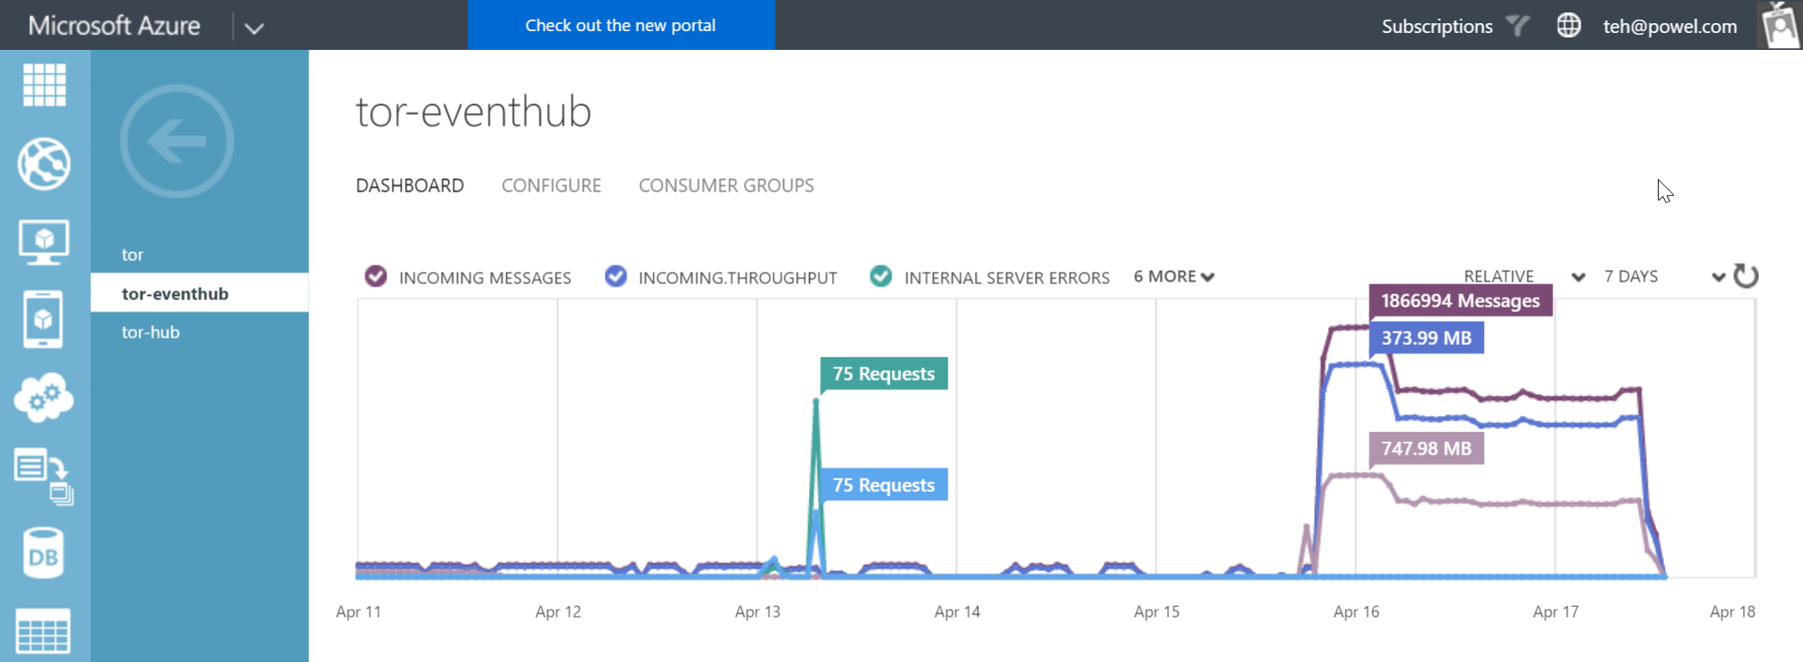

Slide 22
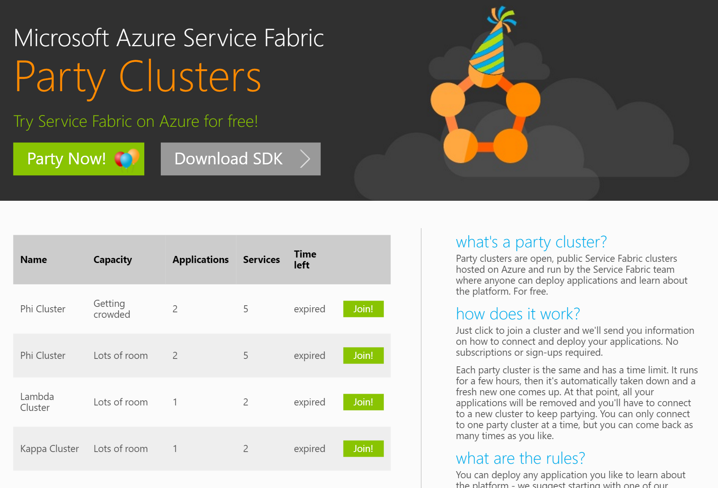

Slide 23
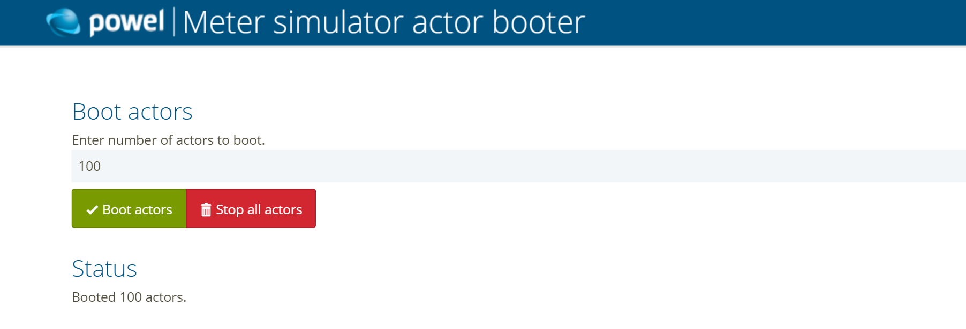

Slide 24
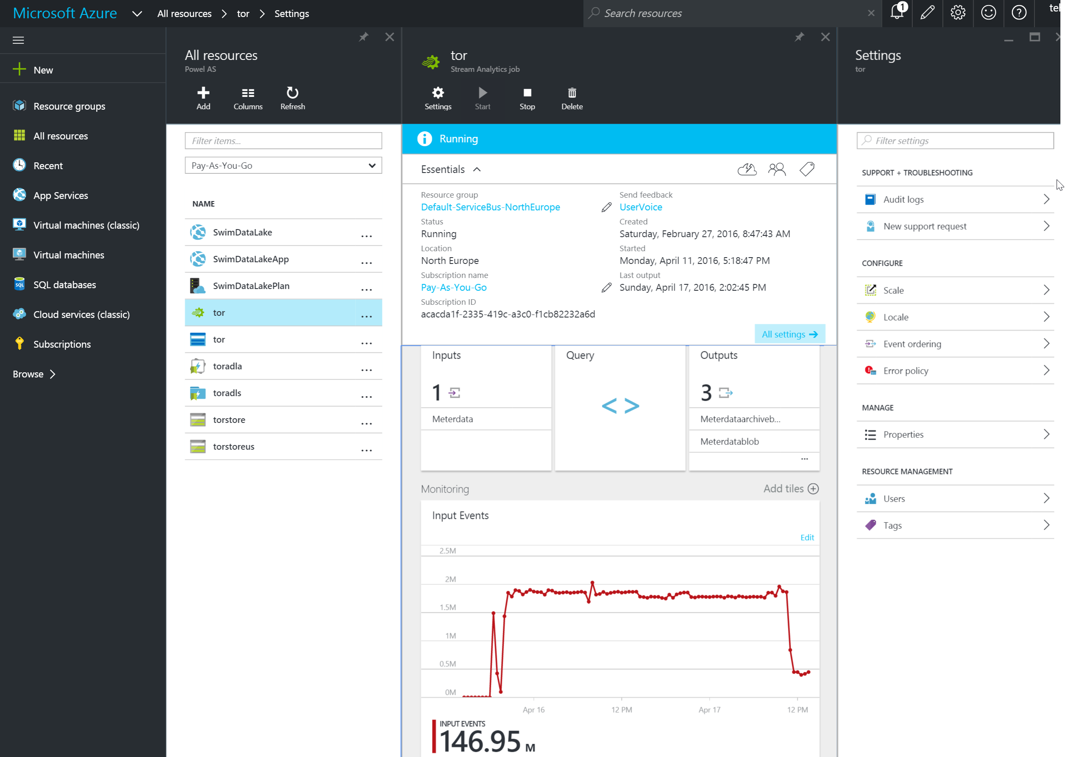

Slide 25
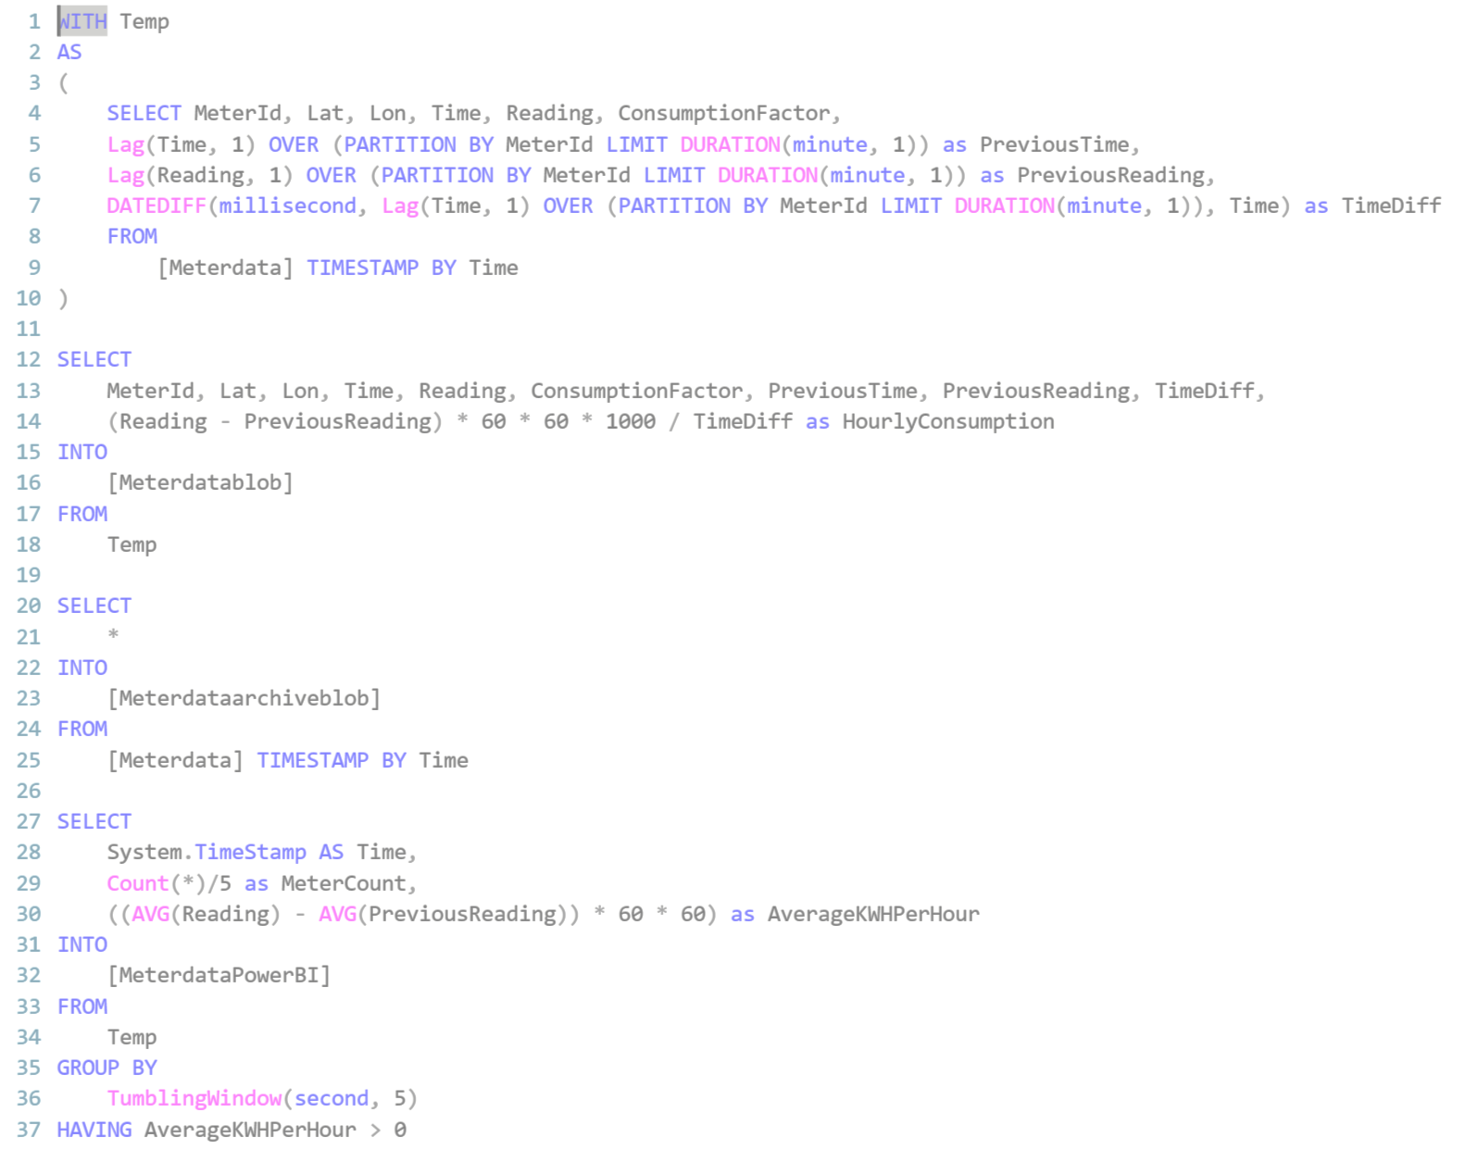

Slide 26
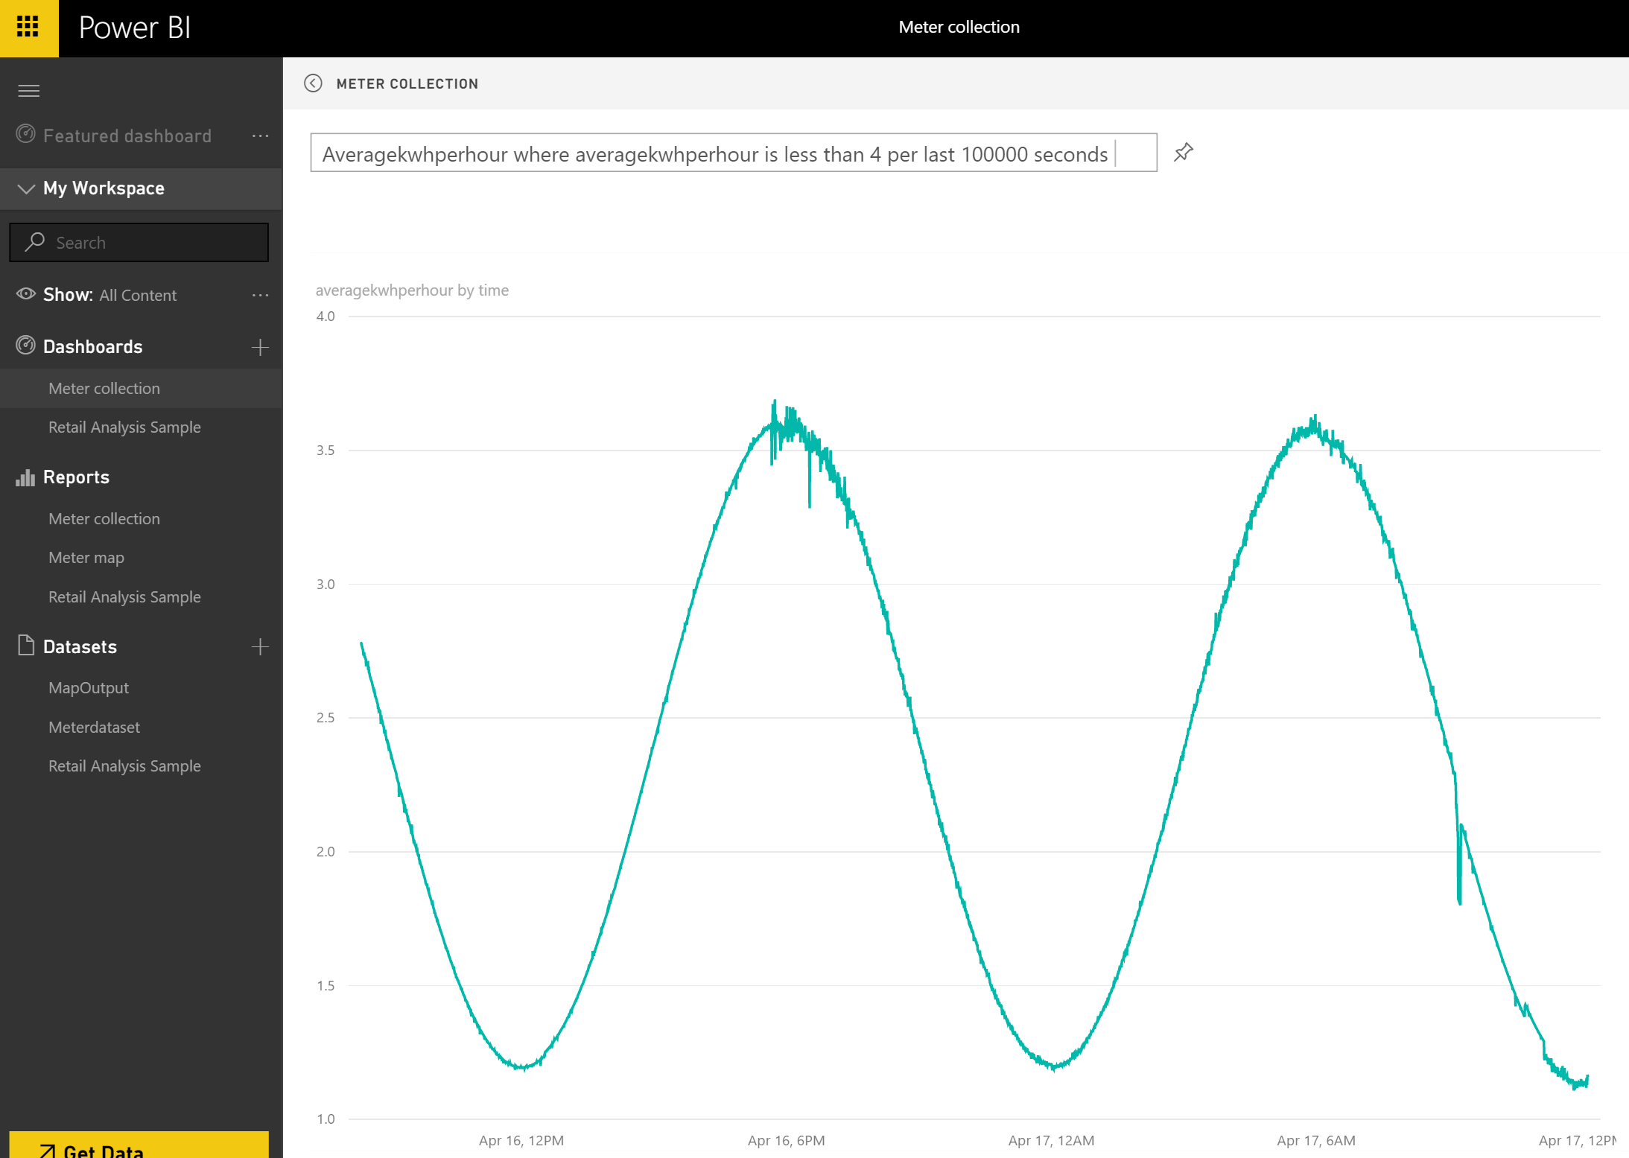

Slide 27
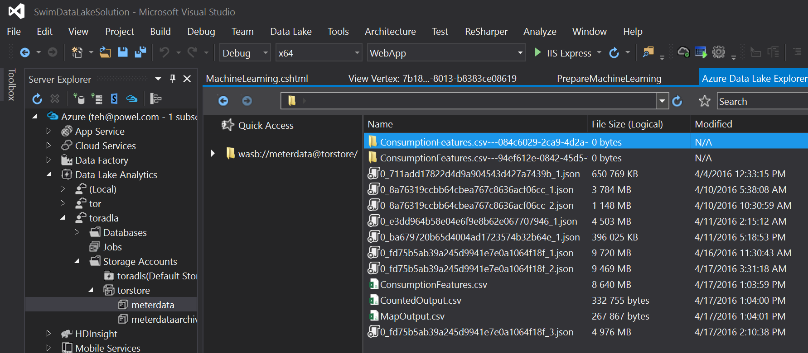

Slide 28
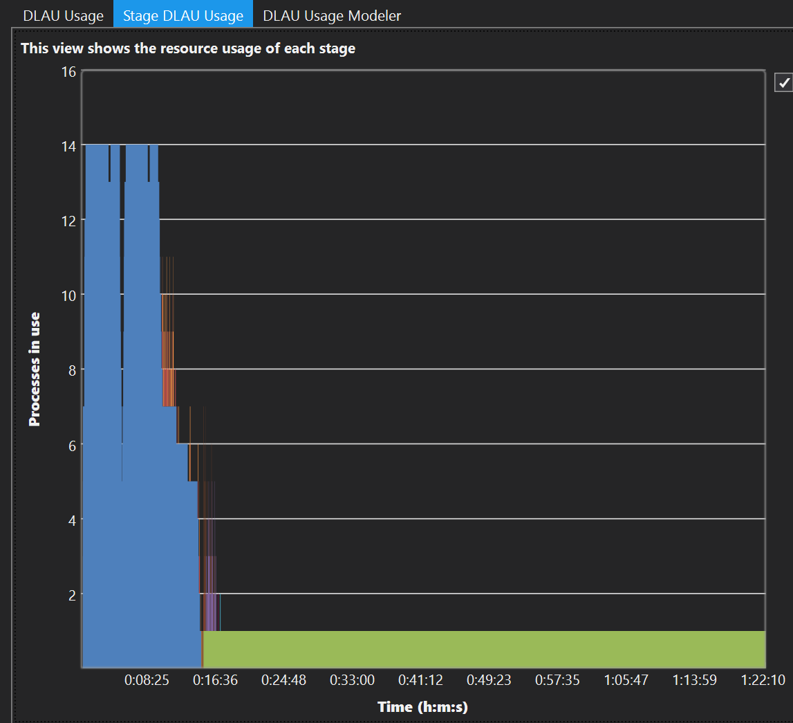

Slide 29
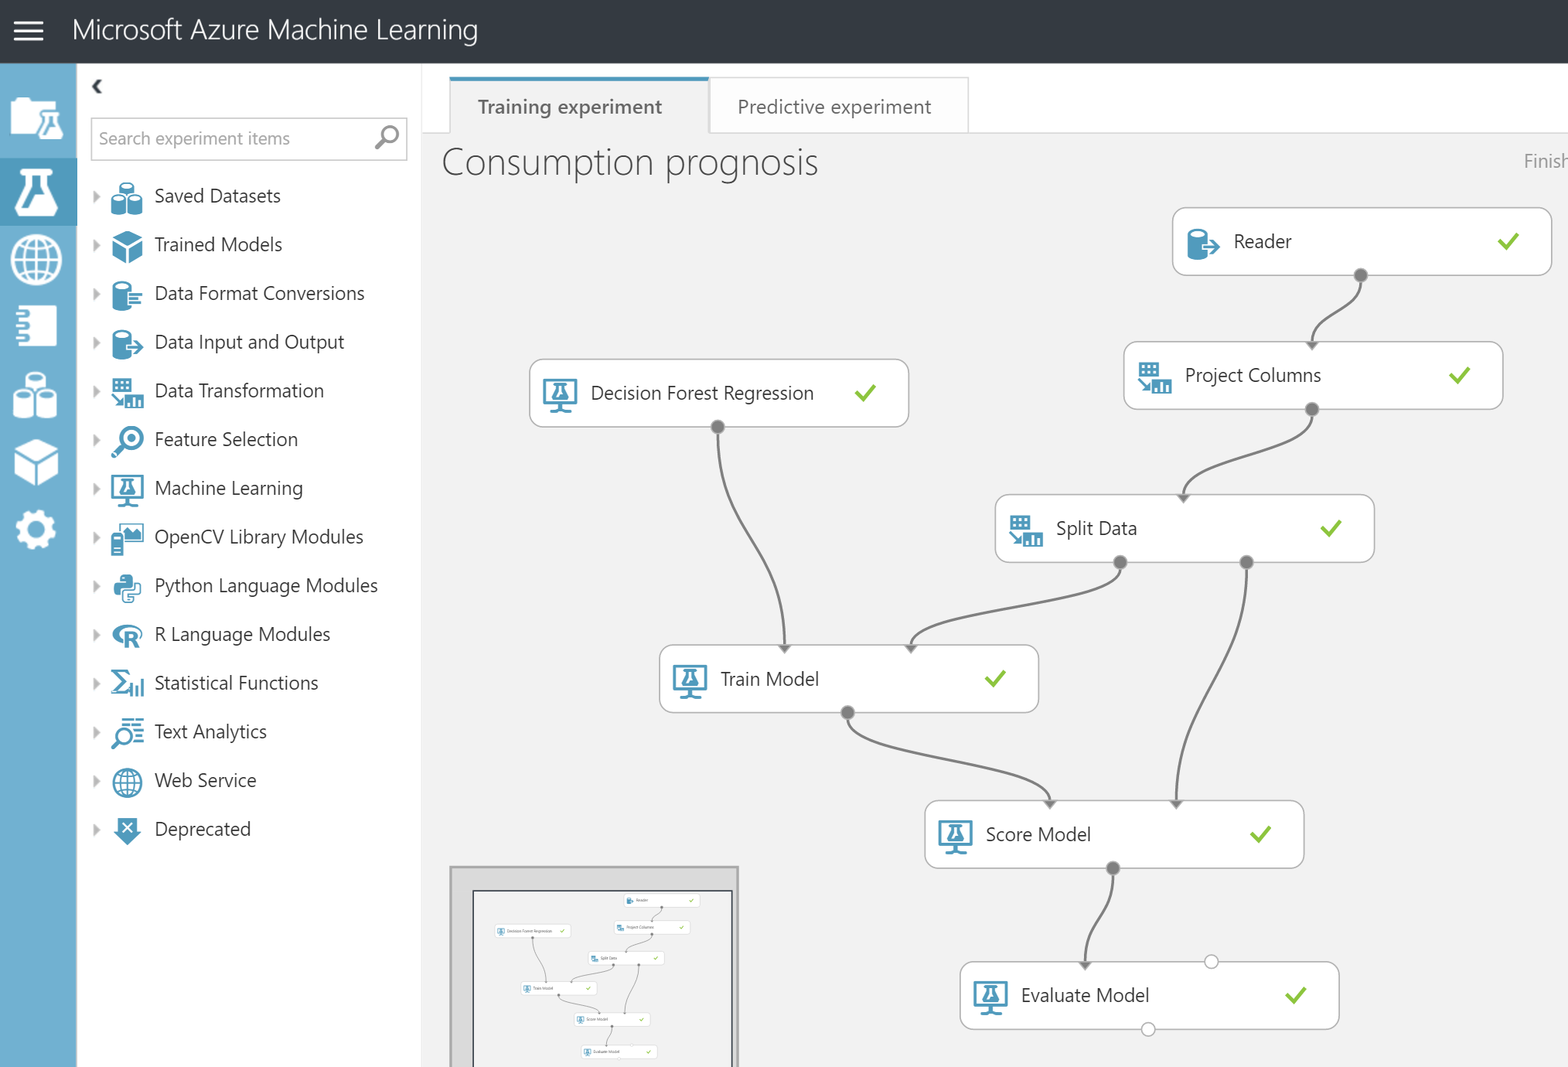

Slide 30
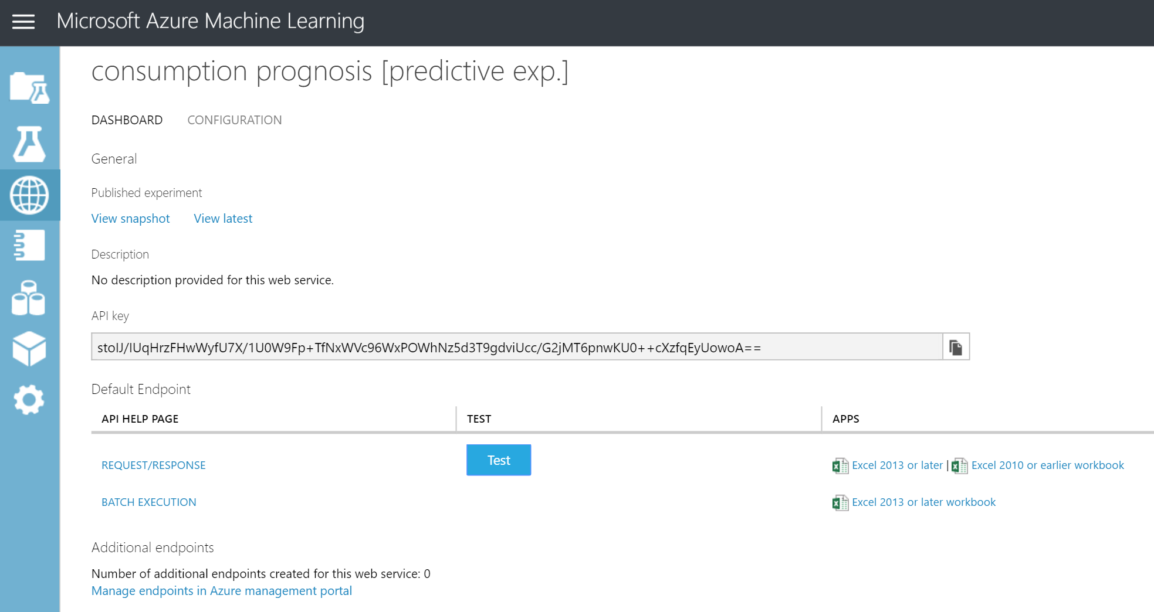

Slide 31
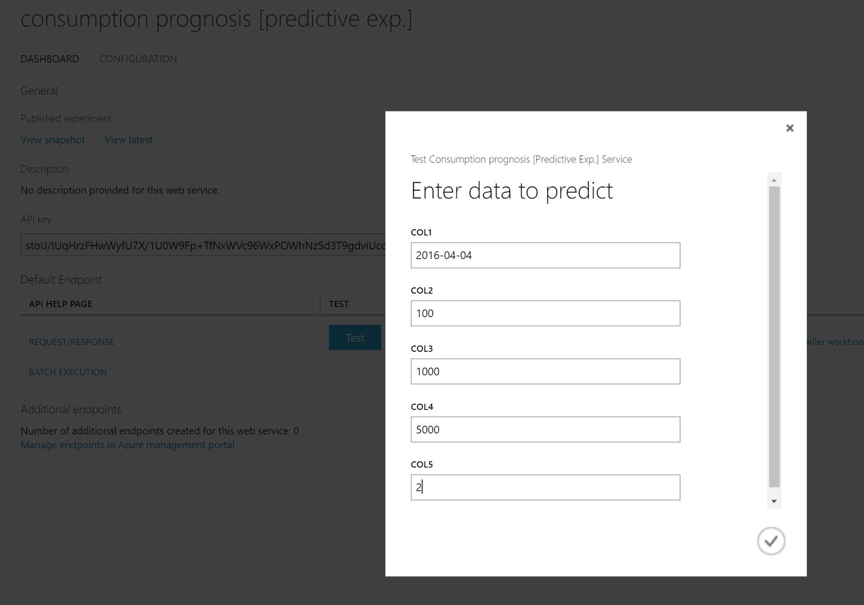

Slide 32
